Slide 1
Road Accidents and Safety Analysis & Prediction
Qifeng Zhou, Mengying Wang
(team 11)

Slide 2
In this project, we use the dataset for Road Safety Data, analysis the relationship between different variables, train the data using Linear Regression and Decision Tree by Spark, and then get some useful information from the results.

Slide 3
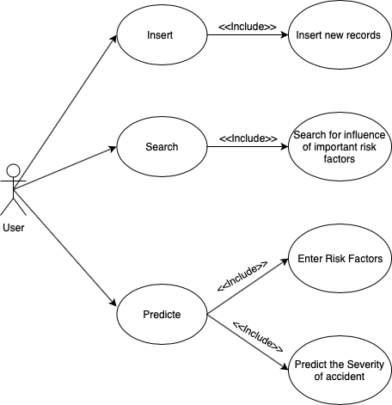
User Case

Slide 4
Data sources
These files provide detailed road safety data about the circumstances of personal injury road accidents in GB from 1979, the types of vehicles involved and the consequential casualties. The statistics relate only to personal injury accidents on public roads that are reported to the police, and subsequently recorded, using the STATS19 accident reporting form. (https://data.gov.uk/dataset/cb7ae6f0-4be6-4935-9277-47e5ce24a11f/road-safety-data)
There are three tables in the datasets: Accident Circumstances, Vehicle and Vehicle, we will choose the useful information for us from them.

Slide 5
Data sources
These are variables in our dataset, the details of the categorical variables in green color
can be found in the ./data/ Road Accidents and Safety Data.xls
Accident Circumstances | Vehicle | Casualty
Accident Index | Accident Index | Accident Index
Police Force | Vehicle Reference | Vehicle Reference
Accident Severity | Vehicle Type | Casualty Reference
Number of Vehicles | Towing and Articulation | Casualty Class
Number of Casualties | Vehicle Manoeuvre | Sex of Casualty
Date (DD/MM/YYYY) | Vehicle Location-Restricted Lane | Age of Casualty
Day of Week | Junction Location | Age Band of Casualty
Time (HH:MM) | Skidding and Overturning | Casualty Severity
Location Easting OSGR (Null if not known) | Hit Object in Carriageway | Pedestrian Location
Location Northing OSGR (Null if not known) | Vehicle Leaving Carriageway | Pedestrian Movement
Longitude (Null if not known) | Hit Object off Carriageway | Car Passenger
Latitude (Null if not known) | 1st Point of Impact | Bus or Coach Passenger
Local Authority (District) | Was Vehicle Left Hand Drive | Pedestrian Road Maintenance Worker (From 2011)
Local Authority (Highway Authority - ONS code) | Journey Purpose of Driver | Casualty Type
1st Road Class | Sex of Driver | Casualty IMD Decile
1st Road Number | Age of Driver | Casualty Home Area Type
Road Type | Age Band of Driver
Speed limit | Engine Capacity
Junction Detail | Vehicle Propulsion Code
Junction Control | Age of Vehicle (manufacture)
2nd Road Class | Driver IMD Decile
2nd Road Number | Driver Home Area Type
Pedestrian Crossing-Human Control
Pedestrian Crossing-Physical Facilities
Light Conditions
Weather Conditions
Road Surface Conditions
Special Conditions at Site
Carriageway Hazards
Urban or Rural Area
Did Police Officer Attend Scene of Accident
Lower Super Ouput Area of Accident_Location (England & Wales only)

Slide 6
Acceptance criteria
Functional Criteria:
User can insert data, search for analysis result and predict base on new data. ✓
Performance Criteria:
95% of queries to be performed in under 4 second. ✓
RMSE of the ML model(s) under 1. ✓

Slide 7
Data Processing & Code Optimization
1. Clean data
2. Create Dataset of each files
3. Union/Join tables to connect the data
4. Transform the Streaming data from other host
5. Update the previous dataset for the upcoming ML
6. Optimization
A."spark.storage.memoryFraction","0.6"
B. "spark.shuffle.file.buffer","64"
C. "spark.serializer", "org.apache.spark.serializer.KryoSerializer“
D. "spark.shuffle.sort.bypassMergeThreshold","300“
E. data persistence level

Slide 8
Data training
Package –
org.apache.spark.ml
Regression –
Linear Regression & Decision Tree
Improve –
Cross-Validation & Parametric Grid
Assistance –
Jupyter Notebook (Python 3)

Slide 9
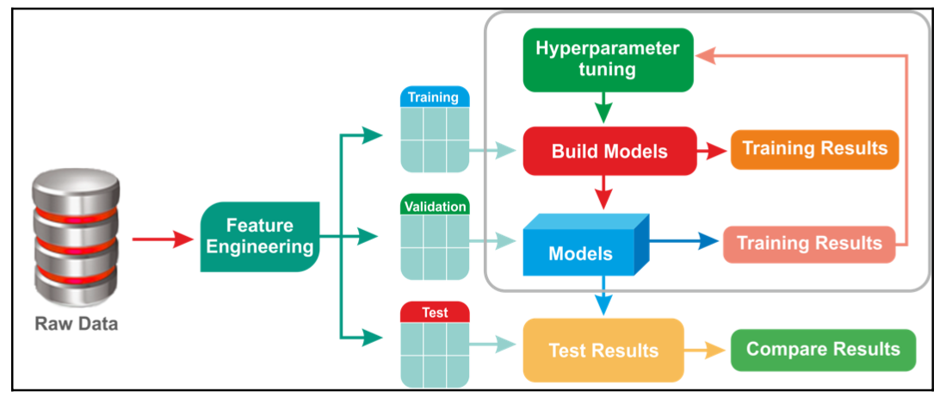
Data training

Slide 10
Conclusion
Complete import and analysis the data.
User can insert new data by streaming.
Training data using machine learning and make the lable feature Predictable.
Generate some plots by Python and reflect relationships between different variables.

Slide 11
Results
Based on data analysis, we found that it is very hard to isolate many of these factors. Instead, there are many influences. These include:
The distance people travel (which is partly affected by economic externalities)
The mix of transport modes used
Behavior of drivers, riders and pedestrians
The mix of groups of people using the road (e.g. changes in the number of newly qualified or older drivers)
External effects such as the weather, which can influence behavior (for instance, encouraging / discouraging travel, or closing roads) or change in the risk on roads (by making the road surface more slippery)
So, remember these and safety first all the time!

Slide 12
Thank you!

